Slide 1


MiNap
Sleep Diary
Presented by:
Anika Raisa Chowdhury
Max Liu
Raphael Chin
Quishi Zhao

Slide 2

Agenda
Introduction
01
03
Researcher’s POV
02
Demonstration
04
Replicate Project

Slide 3

Introduction
01
Goal of the project
Features of the application

Slide 4
Goal
Assist in capturing sleep data to facilitate sleep medicine studies. There would be two kinds of users:
Participants
Researchers

Slide 5
Features and User Story
Login from Mobile App
Record Sleep in Smart Watch
Review in Mobile App
Visualize collected on mobile app/tableau (not for participants)

Slide 6
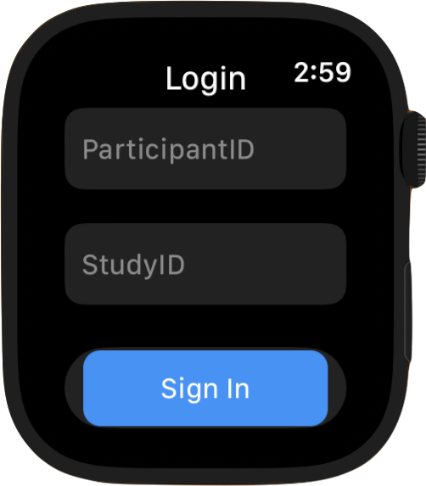
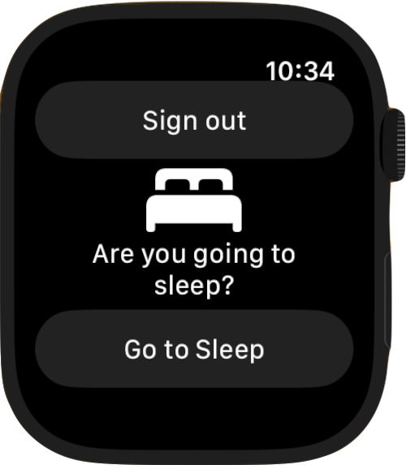
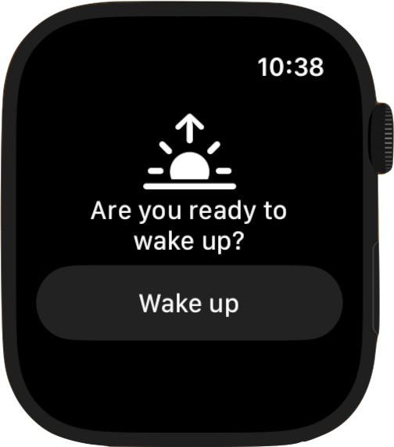
Front End
Login
Go to Sleep
Wake Up
Participants will input their participant IDs and Study IDs to login
Participants can press “Go to Sleep” before they sleep.
Sign out button is there if they decided to sign out.
Participants can press “Wake Up” when awake.
Sign out button is removed to prevent accidental sign out

Slide 7
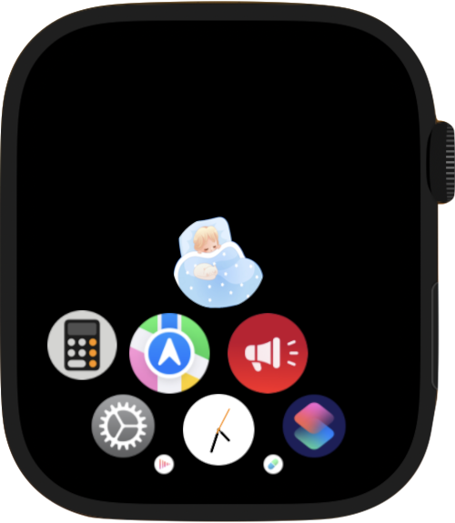

Front End
App Icon
This cute Minap icon allows participants to quickly recognize the app.
Note: Feel free to change the icon if there’s copyright concern/inappropriate
Smartwatch app

Slide 8
Backend Architecture of the Application
Database
Stack and Project Tree
•Cloud - AWS DynamoDB
• Local - Oracle
Script to sync between two platforms
Swift
React Native
Notes:
Talk about how the watch and the mobile app are communicating. Detail on the backend.

Slide 9

Demo

Slide 10
Researcher’s Dashboard
• Sleep pattern by a Participant
• Sleep pattern by Study id.
To be completed if there is time.

Slide 11
Replicating the Project
Deployment
Recommended Design Improvements
Dockerized script to sync the databases.
Deployment to AWS
Publish into Apple App Store
Github: https://github.com/DepressionCenter/MiNap
Branch 1: Mobile - houses the code for the mobile app
Branch 2: frontend-new houses the codes for the iOS smartwatch app.
Separate login for Researchers with customizable access levels hierarchy
Provision to edit and add comments across data.

Slide 12
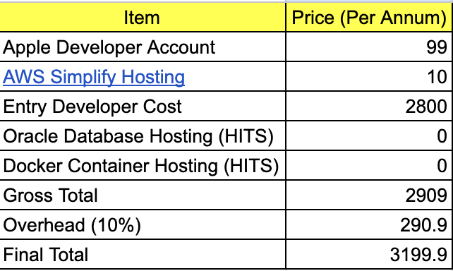
Infrastructure Cost Associated with the Project

Slide 13
Thank you.
Do you have any questions?
minap2023its@umich.edu

